Slide 1
Chapter 12
Clustering, Distance Methods, and Ordination

Slide 2
12.1 INTRODUCTION
Cluster analysis is a more primitive technique in that no assumptions are made concerning the nu-mber of groups or the group structure.

Slide 3
12.2 SIMILARITY MEASURES
Most efforts to produce a rather simple group stru-cture from a complex data set require a measure of “closeness,” or “similarity.” There is often a great deal of subjectivity involved in the choice of a si-milarity measure. Important considerations inclu-de the nature of the variables (discrete, continuous, binary), scales of measurement (nominal, ordinal, interval, ratio), and subject matter knowledge.

Slide 4
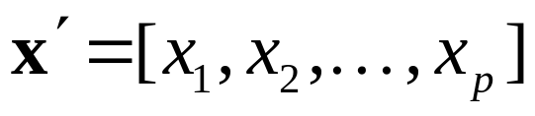
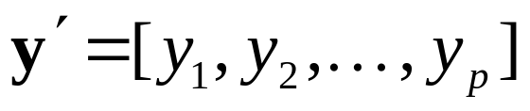
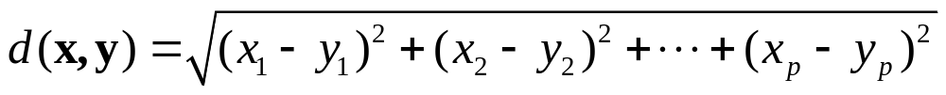
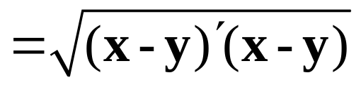
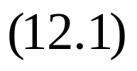
Distances and Similarity Coefficients for Pairs of Items
Recall that the Euclidean (straight-line) distance between two p-dimensional observations (items)
and is, from
(1.12),

Slide 5
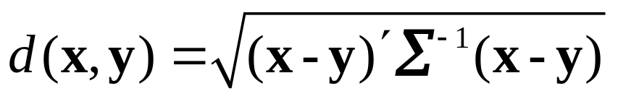
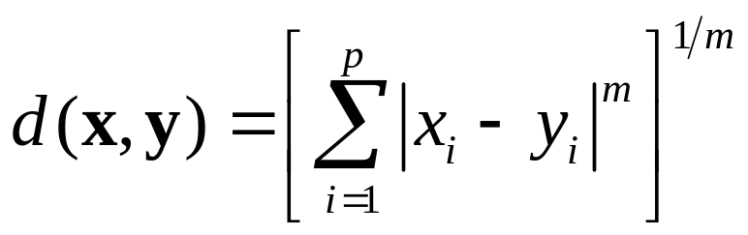
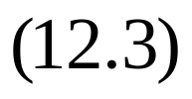

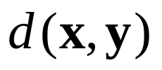

The statistical distance between the same two obs-ervations is of the form [see (1.23)]
Another distance measures is the Minkowski metric
For , measures the “city-block” distan-ce between two points in p dimensions. For ,

Slide 6
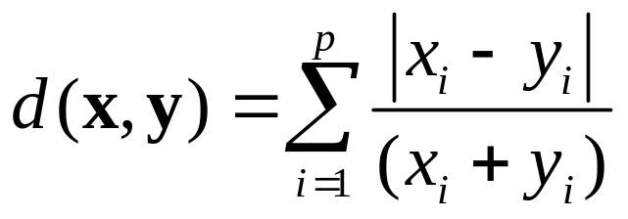
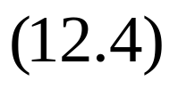
becomes the Euclidean distance. In general, varying m changes the weight given to larger and smaller differences.
Additionally, the measures of “distance” or “dissimilarity” are given by the Canberra metric and Czekanowski coefficient. We have
Canberra metric:

Slide 7
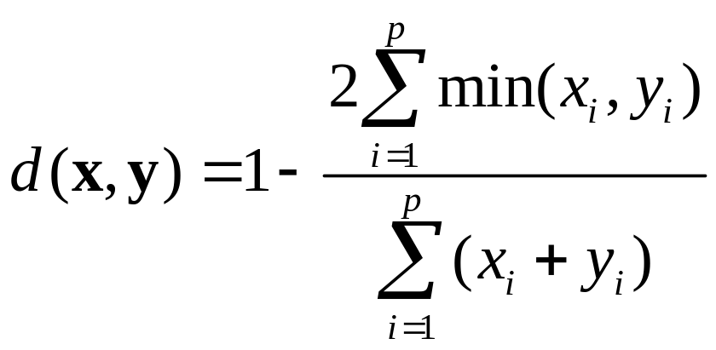
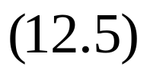
Czekanowski coefficient:

Slide 8
Example 12.1 (Clustering by shading a distance matrix)
P.671

Slide 9
Example 12.2 (Calculating the values of a similar-ity coefficient)
P.675

Slide 10
Similarities and Association Measures for Pairs of Variables
Similarity measures for variables often take the form of sample correlation coefficients.

Slide 11
Concluding Comments on Similarity
It appears that most practitioners use distances [see (12.1) through (12.5)] or the coefficients in Table 12.2 to cluster items and correlations to cluster variables.

Slide 12

Example 12.3 (Measuring the similarities of 11 la-nguages)
P.677
The meanings of words change with the course of history. However, the meaning of the numbers 1,2,
3, represents one conspicuous exception. Thus, a first comparison of languages might be based on the numerals alone.

Slide 13
12.3 HIERARCHICAL CLUSTERING METHODS
Hierarchical clustering techniques proceed by eit-her a series of successive mergers or a series of successive divisions.

Slide 14
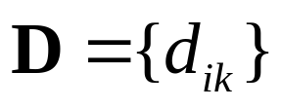


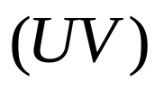
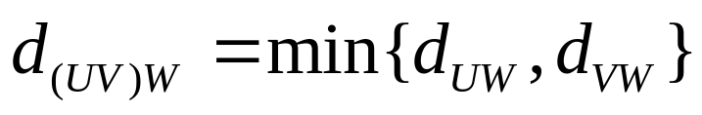

Single Linkage
Groups are formed from the individual entities by merging nearest neighbors, where the term nearest neighbor connotes the smallest distance or largest similarity.
Initially, we must find the smallest distance in
and merge the corresponding objects, say,
and , to get the cluster .

Slide 15
Example 12.4 (Clustering using single linkage)
P.681
To illustrate the single linkage algorithm, we consider the hypothetical distance between pairs of five objects as follows:

Slide 16

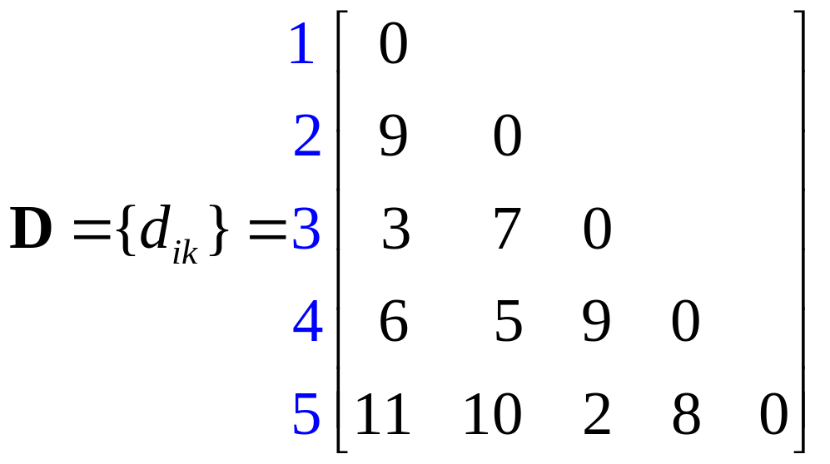

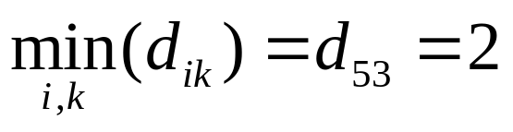
Treating each object as a cluster, we commence clustering by merging the two closest items. Since

Slide 17
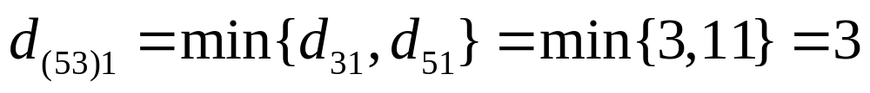
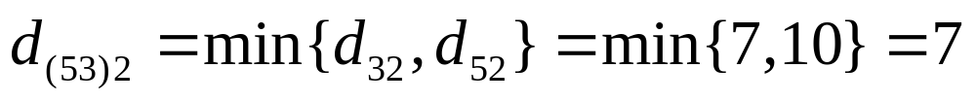
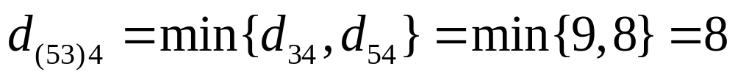
objects 5 and 3 are merged to form the cluster (35). To implement the next level of clustering, we ne-ed the distances between the cluster (35) and the remaining objects, 1, 2, and 4. The nearest neighb-or distances are

Slide 18
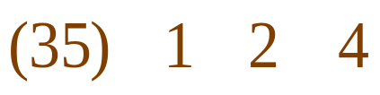
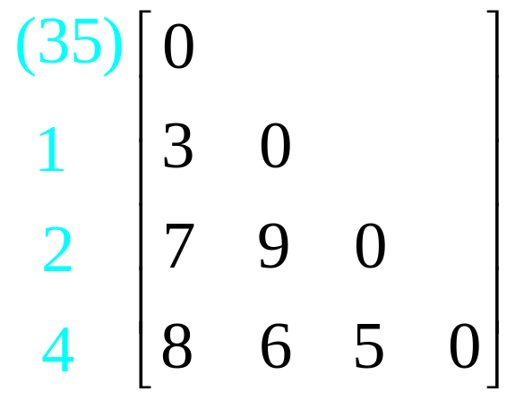
Deleting the rows and columns of D correspondi-ng to objects 3 and 5, and adding a row and colu-mn for the cluster (35), we obtain the new distan-ce matrix

Slide 19
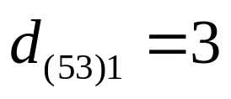
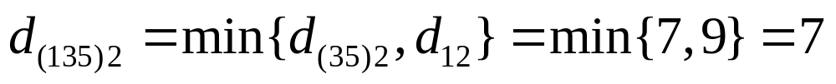
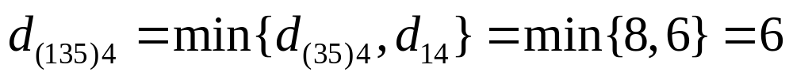
The smallest distance between pairs of clusters is now , and we merge cluster (1) with cl-uster (35) to get the next cluster, (135). Calculat-ing
we find that the distance matrix for the next level of clustering is

Slide 20
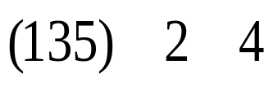
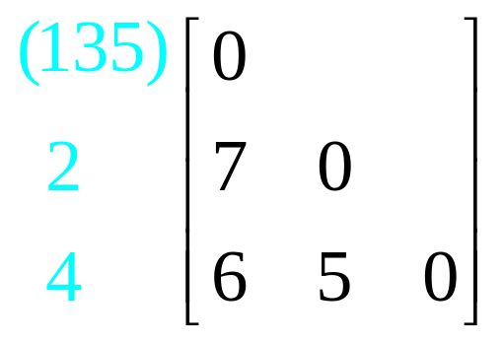
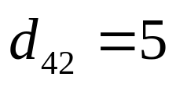
The minimum nearest neighbor distance between pairs of clusters is , and we merge objects 4 and 2 to get the cluster (24).
At this point we have two distinct clusters, (135) and (24). Their nearest neighbor distance is

Slide 21
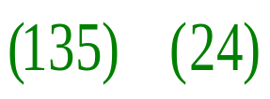
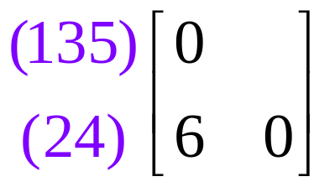
The final distance matrix becomes
Consequently, clusters (135) and (24) are merged to form a single cluster of all five objects, (12345), when the nearest neighbor distance reaches 6.

Slide 22
Example 12.5 (Single linkage clustering of 11 la-nguages)
P.683

Slide 23

Complete Linkage
Complete linkage clustering proceeds in much the same manner as single linkage clusterings, with one important exception: At each stage, the dista-nce (similarity) between clusters is determined by the distance (similarity) between the two elements, one from each cluster, that are most distant.

Slide 24
Example 12.6 (Clustering using complete linkage)
P.685

Slide 25
Example 12.7 (Complete linkage clustering of 11 languages)
P.686

Slide 26
Example 12.8 (Clustering variables using compl-ete linkage)
P.687

Slide 27
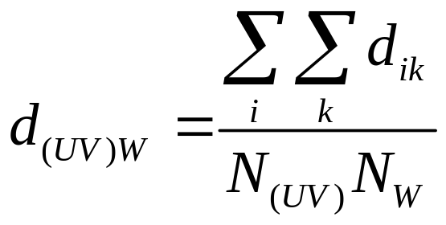
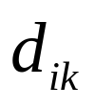
Average Linkage
Average linkage treats the distance between two clusters as the average distance between all pairs of items where one member of a pair belongs to each cluster.
where is the distance between object i in the cl-

Slide 28


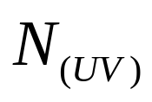
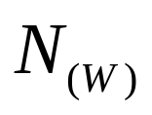
uster and object k in the cluster , and and are the number of items in clusters and , respectively.

Slide 29
Example 12.9 (Average linkage clustering of 11 languages)
P.689

Slide 30
Example 12.10 (Average linkage clustering of pu-blic utilities)
P.690

Slide 31

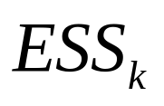
Ward’s Hierarchical Clustering Method
Ward [29] considered hierarchical clustering proc-edures based on minimizing the ‘loss of informat-ion’ from joining two groups. This method is usu-ally implemented with loss of information taken to be an increase in an error sum of squares criterion,
.
First, for a given cluster k, let be the sum of the squared deviation of every item in the clus-ter from the clustr mean (centroid). If there are cu-

Slide 32
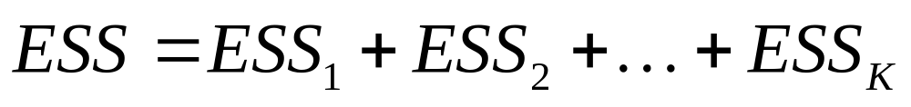
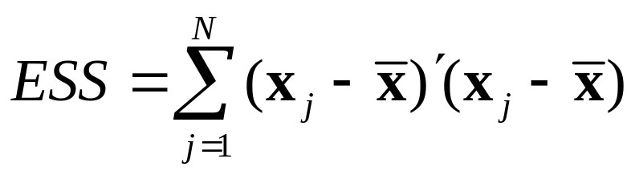

rrently K clusters, define as the sum of the
or the . At each step in analysis, the union of every possible pair of clusters is considered, and the two clusters wh-ose combination results in the smallest increase in
(minimum loss of information) are joined.
where is the multivariate measurement associ-

Slide 33

ated with the jth item and is the mean of all the items.

Slide 34
Example 12.11 (Clustering pure malt scotch whis-kles)
P.691

Slide 35
Final Comments-Hierarchical Procedures

Slide 36
12.4 NONHIERARCHICAL CLUSTERING METHODS
Nonhierarchical clustering techniques are design-ed to group items, rather than variables, into a col-lection of K clusters. The number of clusters, K, may either be specified in advance or determined as part of the clustering procedure.

Slide 37
K-means Method
MacQueen [22] suggests the term K-means for de-scribing an algorithm of his that assigns each item to the cluster having the nearest centroid (mean). In his simplest version, the process is composed of these three steps:
1. Partition the items into K initial clusters.
2. Proceed through the list of items, assigning an item to the cluster whose centroid (mean) is neare-

Slide 38
st. Recalculate the centroid for the cluster receiv-ing the new item and for the cluster losing the it-em.
3. Repeat Step 2 until no more reassignments take place.

Slide 39
Example 12.12 (Clustering using the K-means method)
P.695

Slide 40
Example 12.13 (K-means clustering of public util-ities)
P.696

Slide 41
Final Comments-Nonhierarchical Procedures

Slide 42

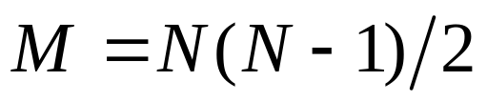
12.5 MULTIDIMENSIONAL SCALING
The Basic Algorithm
For items, there are similarities (distances) between pairs of different items. These similarities constitute the basic data. (In cases wh-ere the similarities cannot be easily quantified as, for example, the similarity between two colors, the rank orders of the similarities are the basic data.)

Slide 43
Example 12.14 (Multidimensional scaling of U.S. cities)
P.702

Slide 44
Example 12.15 (Multidimensional scaling of public utilities)
P.704

Slide 45
Example 12.16 (Multidimensional scaling of univ-ersities)
P.706

Slide 46
12.6 CORRESPONDENCE ANALYSIS
Developed by the French, correspondence analy-sis is a graphical procedure for representing assoc-iations in a stable of frequencies or counts.

Slide 47
Example 12.17 (Correspondence analysis of arch-aeological data)
P.709

Slide 48
Algebraic Development of Correspondence Anal-ysis

Slide 49
Final Comments

Slide 50
12.7 BIPLOTS FOR VIEWING SAMPLING UNITS AND VARIABLES

Slide 51
12.8 PROCRUSTES ANALYSIS: A METHOD FOR COMPARING CONFIGURAYIONS

